Slide 1
Diversity Program Construction Updates For Prime and Subcontractors
Shonnah Paredes, Manager of Diversity Programs
Larry Woods, Diversity Construction Supervisor
July 28, 2023
Notes:
Shonnah Start

Slide 2
Agenda
Disparity Study Recommendations
New Documents and Forms
Diversity Program Updates
2
Notes:
Shonnah

Slide 3
Disparity Study Recommendations
Apply New M/WBE Subcontract Goals
Apply New Workforce Goals
Clarify M/WBE participation for Trucking
Consider Sheltered Market Programs (Small Contractor Program)
Mentor-Protégé Programs to build the capacity of M/WBE’s
Require reporting of all MWBE’s and non-MWBE subcontractors
Update MSD’s compliance and monitoring software tracking system
3
Notes:
Shonnah

Slide 4
Document Updates
and Forms
Non-Building Construction Guideline (Draft) & Guideline Outline (Building and Non-Building)
MSD Form A – Subcontractor Utilization Form
MSD Form B – Good Faith Efforts
MSD Form C – Subcontractor Utilization (Except Form A Subcontractors)
MWBE Subcontractor Verification Form
New Subcontractor Request Form
4
Notes:
Larry

Slide 5
Guideline Outline for Building and Non-Building Construction Projects
Updates and Changes (Yellow Highlights) are the focus for today’s information session.
Session is recorded and will be posted on Diversity website
New forms and guidelines will be posted of August 1, 2023
Contracts advertised after August 1, 2023
5
Notes:
Larry

Slide 6
New Subcontract Goals
Building Construction
21% MBE
10% WBE
Non-Building Construction
10% MBE
10% WBE
MBE participation verified by certification status.
Firms possessing both MBE and WBE certification must be identified under only one category to meet participation goals at the time of bid.
M/WBE goal participation will only count for scopes covered under the MWBE’s industry certifications.
6
Notes:
Larry - MBE – What’s an MBE and what categories count - Section A - Page 1 last paragraph
Subcontract Goals – Page 2
Certification Agencies – Page 2 – MSD is NOT a Certification Agency

Slide 7
New Workforce Goals
Building Construction & Non-Building Construction
37% Minority
11% Women
46% Apprentice (Combined)
Project over $500,000
Trades covered by Prevailing Wage Order counts as “Boots On The Ground” to meet participation goals.
7
Notes:
Larry - Workforce Goals – Page 2

Slide 8
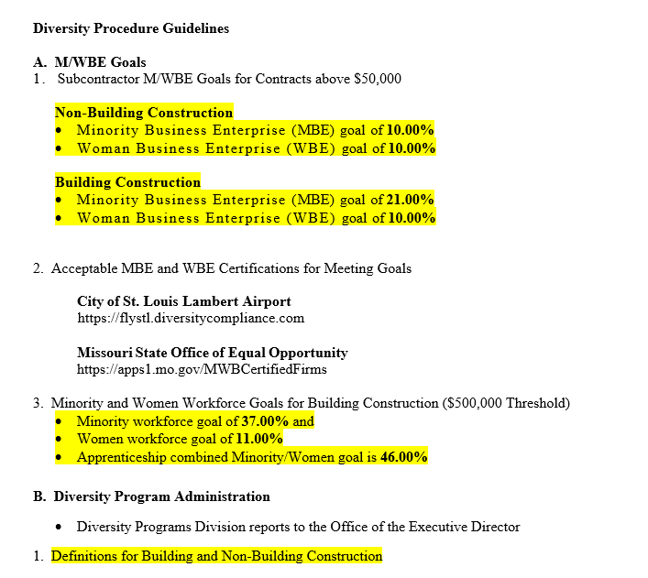
8
Notes:
Larry - We’ve added some definitions that start on Page 3-4 of the draft document that were added to assist with some of the terms you may hear us using at MSD.
Back to the outline,

Slide 9
General Program Guidelines
CUF – Commercial Useful Function
Pre and Post Award Good Faith Efforts
Joint Ventures
Mentor Protégé
Tier Levels of Participation
Ownership Relationships
Two Party Checks (Only for Fringes)
Mobilization
Immediate Need/Emergency Projects
9
Notes:
Shonnah

Slide 10
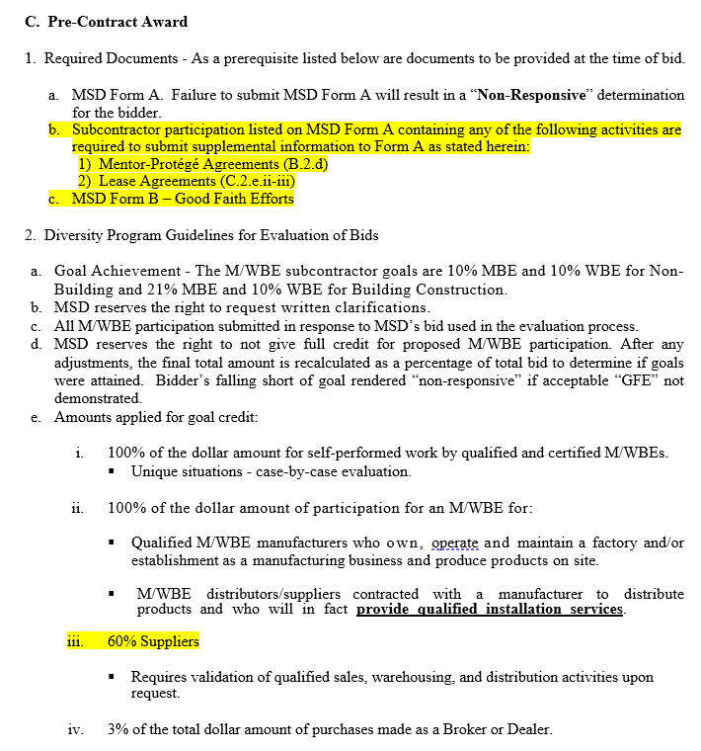
10
Notes:
Shonnah - Now I’m back on Page 3 of the Outline under Pre-Contract Award – Section C
We will need Form A
Form B and GFE documentation
Any Agreements that may affect your goal participation on Form A
I’ll go into a little more details about Good Faith Efforts in a moment, but this is what we need with your bids up front. Then when we evaluate what you submitted the next section show how we count the participation you listed.
Qualified and Certified MWBE’s meeting all the requirements for 100% to furnishing/installation and self performing all of their scope generally gets 100% of the dollar amount towards the goals.
Notice that Suppliers now get 60% credit instead of 20%.

Slide 11
Fees and Commissions
11
Notes:
Shonnah - In this next slide, I’m still on Page 3 but at the bottom
Under this category, we do not allow fees and commissions to be used to meet goals because they do not pass as serving a commercially useful function. All work is subject to serving a commercially useful function on the construction project for compliance purposes.

Slide 12
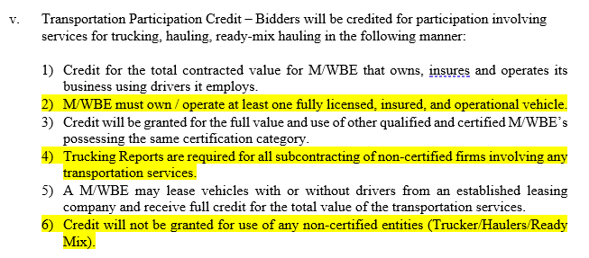
Transportation (Trucking)
Any form of transportation.
Any participation other than Form A sub requires Trucking Reports with documentation.
No credit is allowed for non-certified participation.
12
Notes:
Larry - As a result of the Disparity Study, we’ve added clarification regarding transportation, trucking, hauling

Slide 13
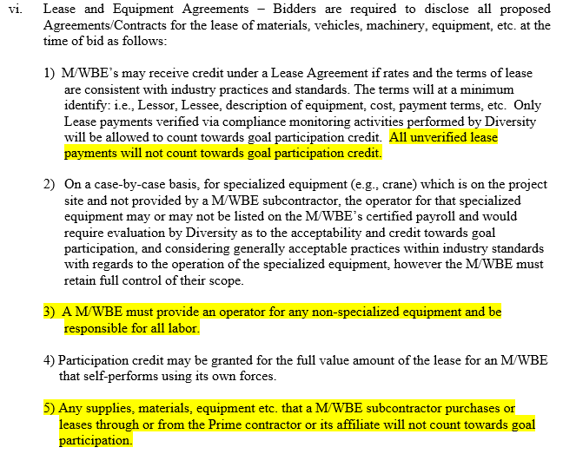
Lease and Equipment Agreements
13
Notes:
Shonnah - In this slide is also on Page 4
Leases and equipment Agreements should be disclosed up front.
Special circumstances will be evaluated on a case by case basis, however, they still should be disclosed as soon after the determination is made that an MWBE will engage in that type of activity. We say this because when were doing compliance, we’re going to ask about equipment that’s being used.

Slide 14
Evaluation of Good Faith Efforts (GFE)
Good Faith Efforts are quantified with a minimum score of 90 of the total 100 available points as follows:
Advertisements (15 Points)
Outreach (15 Points)
Professional Advocacy Contact (10 Points)
Pre-Bid Meeting (10 Points)
Contacting an adequate number of M/WBE’s (20 Points)
Contracting in good faith with M/WBE’s (20 Points)
Justification Statement (10 Points)
14
Notes:
Shonnah - Good Faith Efforts start at the bottom of Page 4 and are now on a points system for passing good faith efforts as you can see here

Slide 15
Post Award Compliance
NOA and NTP Issued
Pre-Construction Meeting
Receive Reporting Requirements Email from Diversity
Monthly Utilization Reports are required for all subcontractors.
Form C must be completed in its entirety to ensure non-certified subs will be able to confirm payments.
On-Site Compliance Monitoring (Compliance Specialist/Inspectors).
GFE’s are required when there is an anticipated shortfall or when an MWBE cannot perform.
15
Notes:
Larry

Slide 16
Post Award Compliance
I encourage everyone to read through the draft document prior to August 1st, 2023 and submit or ask any questions you may have with any of the Diversity staff you are currently working with.
Diversity Contact Information
Diversity@stlmsd.com
Shonnah Paredes, Manager of Diversity Programs
sparedes@stlmsd.com
Larry Woods, Diversity Construction Supervisor
lwoods@stlmsd.com
16
Notes:
Shonnah

Slide 17
Thank You

